Slide 1


Hi, I am Yingtao.
Education: MS in Computer Science at University of Washington (U.S.)
BS in Physics and Computer Science at Huazhong University of Sci and Tech (China)
Employment History: Microsoft Research Asia (current), ByteDance, Baidu, Bosch
Experience: AI Healthcare (EHR, Risk, …), AI Business (Credit Scoring, Recommender System, …)
Methodology: Neural ODE/PDE, Causal Representation Learning, Out-Of-Distribution (OOD), …
Why interested: Highly aligned research directions; research impact and values; no courses, …

Slide 2
Stable Learning for AI Health - Preliminary
I have been interested in causal representation learning for health and business problems.
Authors | Title | Funding/Coop | Submission
Liu, Z., Luo, Y., Zheng, D., Liu, Q., Zhong, R., Chang, D., Kong, D., Chen, Z. | Deep Stable Multi-Interest Learning for Sequential Recommendation | Funded by KuaiShou. U.S. dollar ~ 80000 | KDD 22’
Luo, Y., Liu, Z., Liu, Q. | Deep Stable Representation Learning on Electronic Health Records | Funded by Wenzhou Medical University. U.S. dollar ~ 30000 | KDD 22’

Slide 3
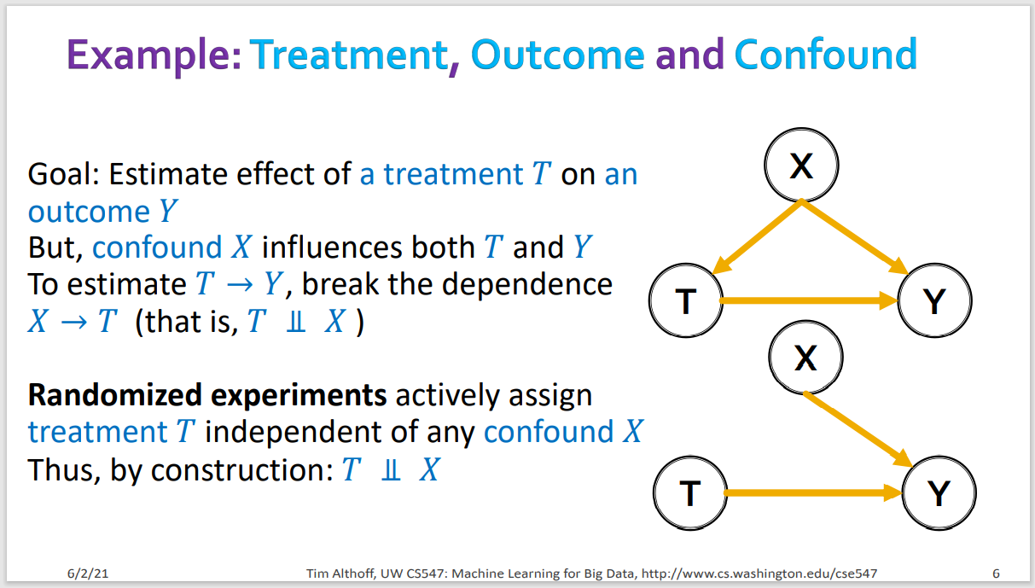
Some Backgrounds on Causal Inference

Slide 4
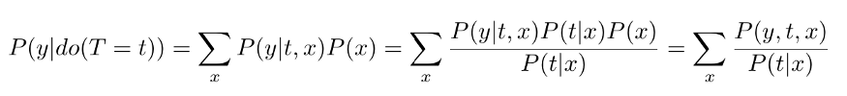
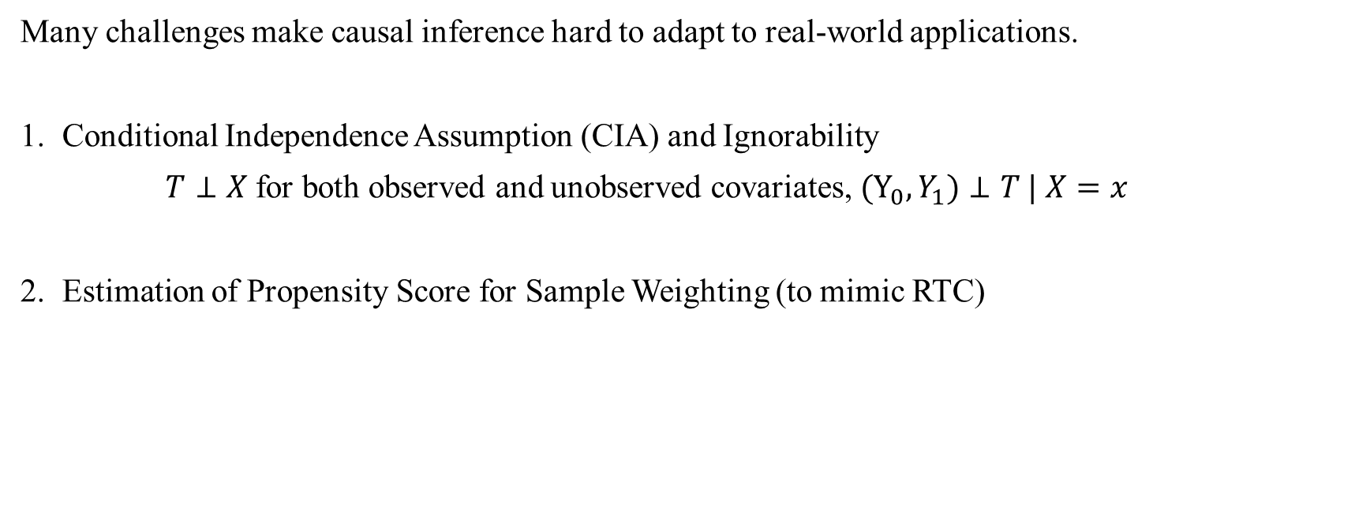
Some Backgrounds on Causal Inference
Many challenges make causal inference hard to adapt to real-world applications.
1. Conditional Independence Assumption (CIA) and Ignorability
$T⊥X$ for both observed and unobserved covariates, $(Y_{0}, Y_{1})⊥T | X=x$
2. Estimation of Propensity Score for Sample Weighting (to mimic RTC)
Propensity estimation accuracy: What if there are numerous Ts with limited data?

Slide 5
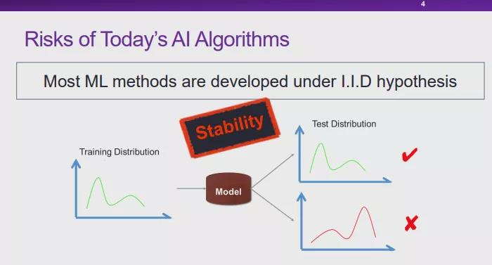
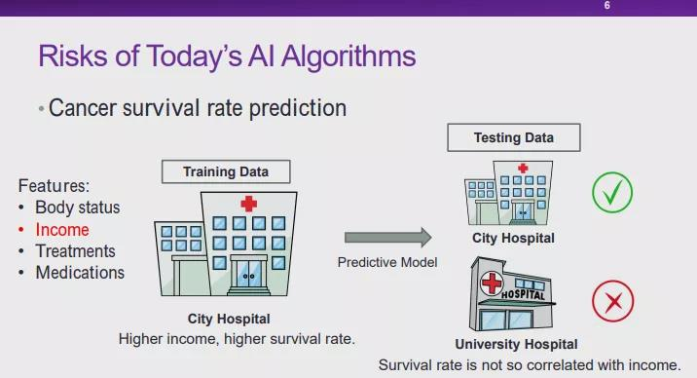
Some Backgrounds on OOD
Training and test distributions are not I.I.D.(independent and identically distributed)
Most OOD methods (domain adaption, causal transfer learning, etc.) need test distribution.

Slide 6
Stable Learning as Causation + OOD
Stable Learning aims at removing spurious relations and make stable prediction across distributions.
We adapt this technique (previously on linear models) to deep learning scheme for applications.
Authors | Title | Conference
Kun Kuang, et al. | Stable Prediction across Unknown Environments | KDD 18’
Zheyan Shen, Peng Cui, Tong Zhang, Kun Kuang. | Stable Learning via Sample Reweighting | AAAI 20’
Zheyean Shen, et al. | Stable Learning via Differentiated Variable Decorrelation | KDD 20’
Xingxuan Zhang, et al. | Deep Stable Learning for Out-Of-Distribution Generalization | CVPR 21’

Slide 7
Diagnoses Prediction based on EHR
Sequential Electronic Health Records (EHR) with diagnosis and procedure information.
ICD-9 codes denote different diagnoses and treatments.
Can we make a prediction?
1st Diagnosis
2nd Diagnosis
3rd Diagnosis
“If: 4th Diagnosis”
9971: Cardiac complications
4400: Atherosclerosis of aorta
43331
99812
436
43320
4019
???
???
???
???
???
9971
4400
56983
56089
49121
3950: Angioplasty Of Other Non-Coronary Vessel
3818: Endarterectomy, Lower Limb Arteries
9904: Transfusion Of Cells
0044: Procedure On Vessel Bifurcation
2017
3950
3818
9904
0044
2018
2019
2020
2021
Timeline
4573
311
4621
5472
3323
3601
3606
1st Procedure
2nd Procedure
3rd Procedure

Slide 8
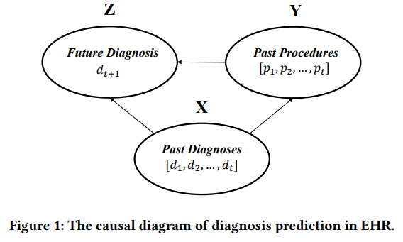
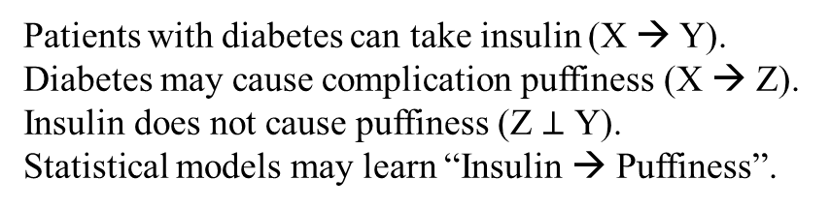
Causal Diagram on EHR
In this case, Y → Z would be spurious.
Here, X, Y, Z only denote variables.
Z
Y
Puffiness
?
Insulin
X
Diabetes
Patients with diabetes can take insulin (X → Y).
Diabetes may cause complication puffiness (X → Z).
Insulin does not cause puffiness (Z $⊥$ Y).
Statistical models may learn “Insulin → Puffiness”.

Slide 9
Causal Diagram on EHR
Spurious Y → Z cannot generalize.
Z
Y
Puffiness
?
Diet
X
Diabetes
No Insurance
X → Z is causal and stable in various environments.
When X → Y change (distribution shift),
statistical models may not generalize well.

Slide 10
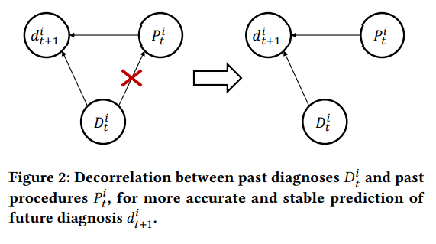
Stable Learning on EHR
Spurious Y → Z will be removed.
Z
Y
Puffiness
Insulin
X
Diabetes
Causal inference requires the conditional covariance between Treatment and Covariates to be zero. Here, X and Y shouldn’t be correlated to remove spurious relation.

Slide 11
Stable Learning on EHR
Stable Learning aims at removing spurious relations and make stable prediction across distributions.
Q: How to measure conditional covariances between diagnoses and procedures?
A: Hilbert Schmidt Independence Criterion (HSIC) [1,2].
Q: How to minimize conditional covariances during/before model training?
A: Sample weighting (just like inverse propensity weighting).
[1] Daniel Greenfeld and Uri Shalit. 2020. Robust learning with the hilbert-schmidt independence criterion. In ICML. 3759–3768.
[2] Arthur Gretton, Kenji Fukumizu, Choon Hui Teo, Le Song, Bernhard Schölkopf, Alexander J Smola, et al. 2007. A kernel statistical test of independence.. In NeurIPS. 585–592.

Slide 12
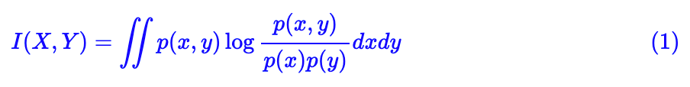
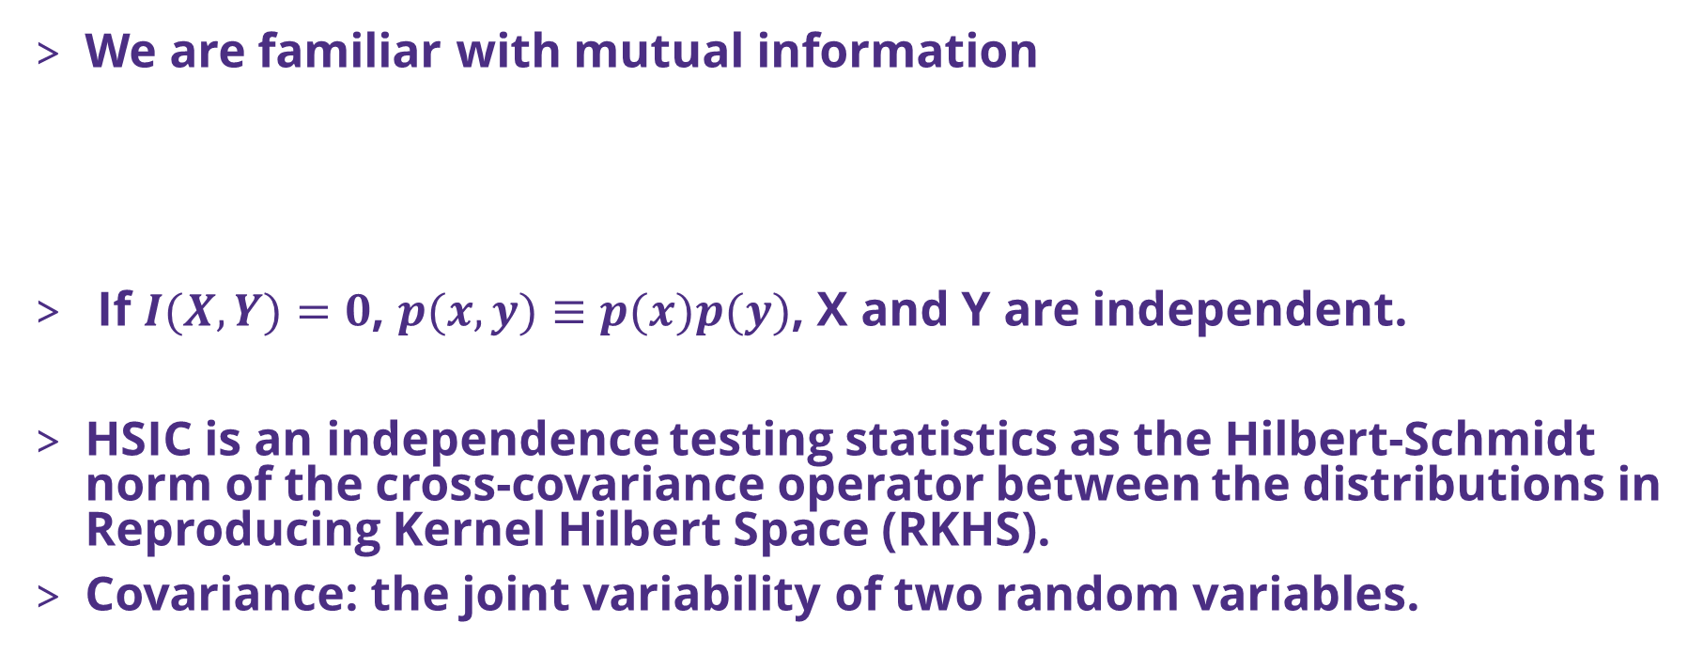
What is HSIC?
We are familiar with mutual information
If $I(X,Y)=0$, $p(x,y)≡p(x)p(y)$, X and Y are independent.
HSIC is an independence testing statistics as the Hilbert-Schmidt norm of the cross-covariance operator between the distributions in Reproducing Kernel Hilbert Space (RKHS).
Covariance: the joint variability of two random variables.

Slide 13
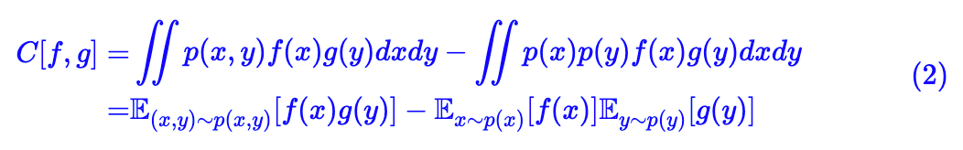
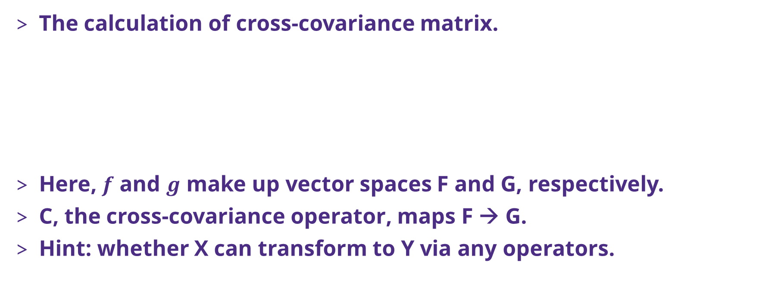
The computation of HSIC
The calculation of cross-covariance matrix.
Here, $f$ and $g$ make up vector spaces F and G, respectively.
C, the cross-covariance operator, maps F → G.
Hint: whether X can transform to Y via any operators.

Slide 14
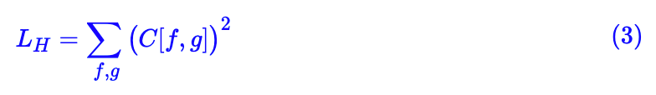
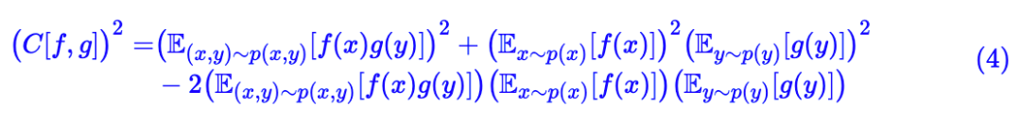
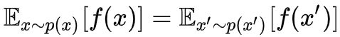
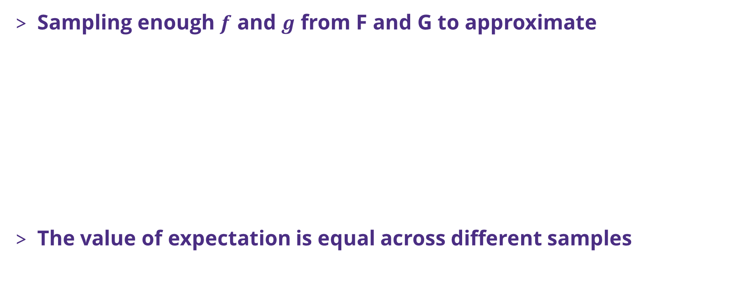
The computation of HSIC
Sampling enough $f$ and $g$ from F and G to approximate
The value of expectation is equal across different samples

Slide 15
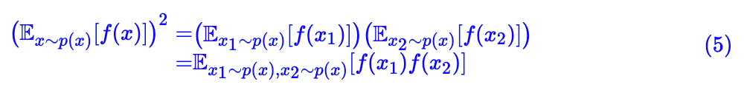
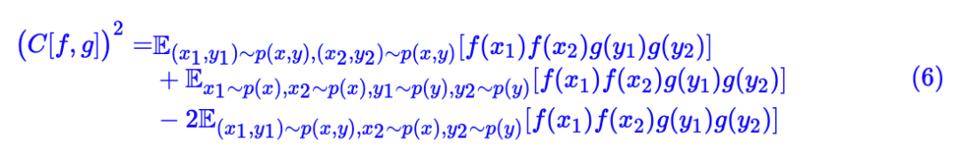
The computation of HSIC
Therefore, we can convert the square into two samples.
Now, we find it is hard to transverse F and G for estimation.

Slide 16
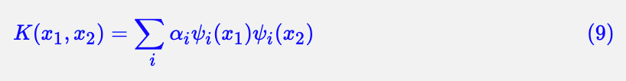
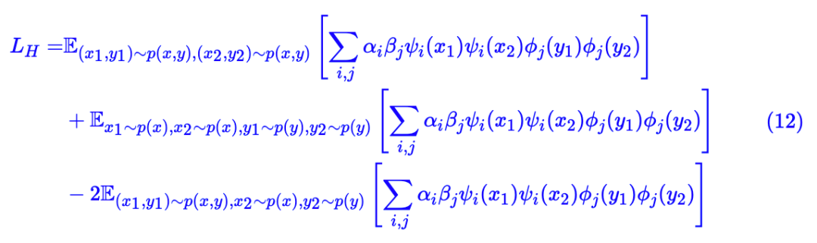
The computation of HSIC
No worries! The kernel trick can reduce calculation time!

Slide 17
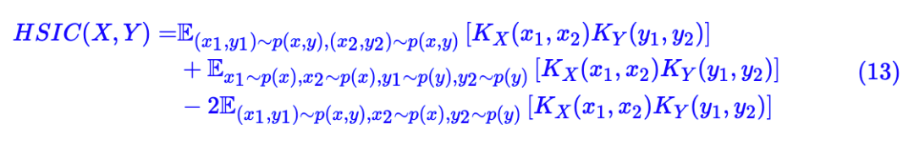
The computation of HSIC
In essence, we have the HSIC:
With K being any kernel functions, we will have
The time complexity is dependent on the size of X and Y.

Slide 18
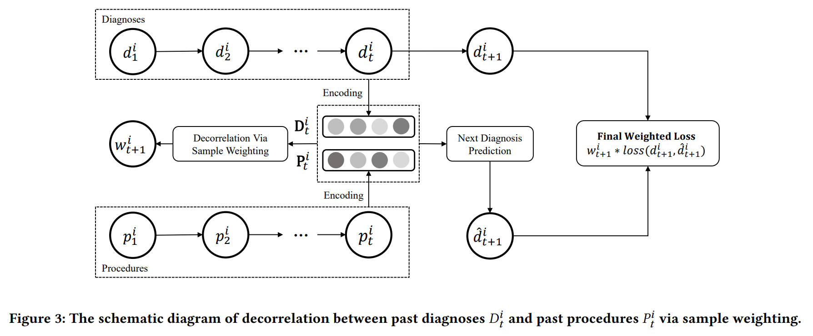
Stable Learning on EHR

Slide 19
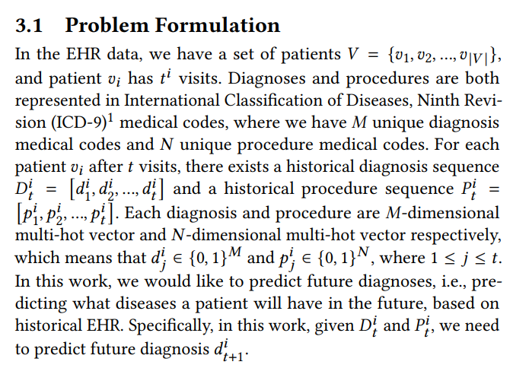
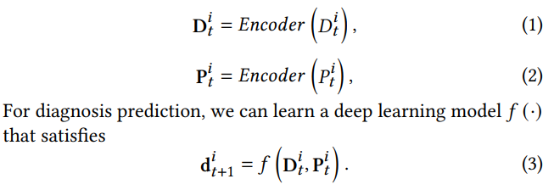
Stable Learning on EHR
First, we map diagnoses and procedures to embedded latent space (for deep learning).

Slide 20
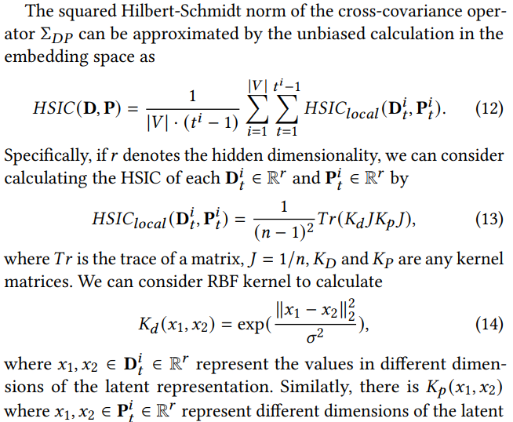
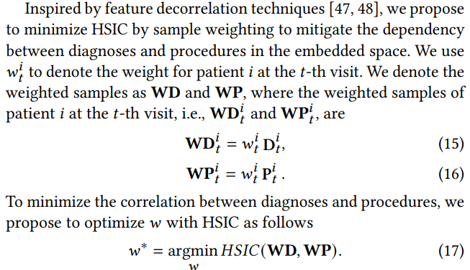
Stable Learning on EHR
This means, we decorrelate each time’s diagnosis and procedure for each patient.

Slide 21
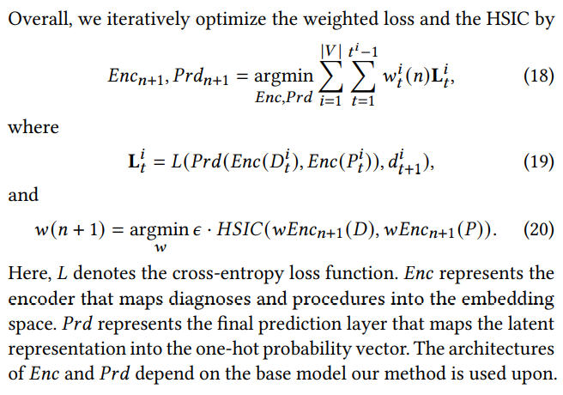
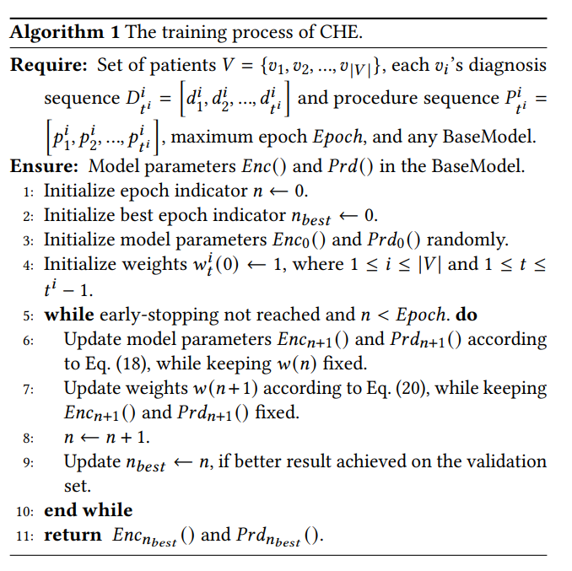
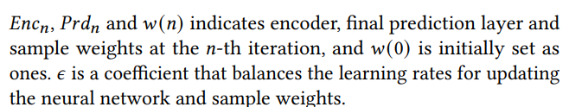
Stable Learning on EHR

Slide 22
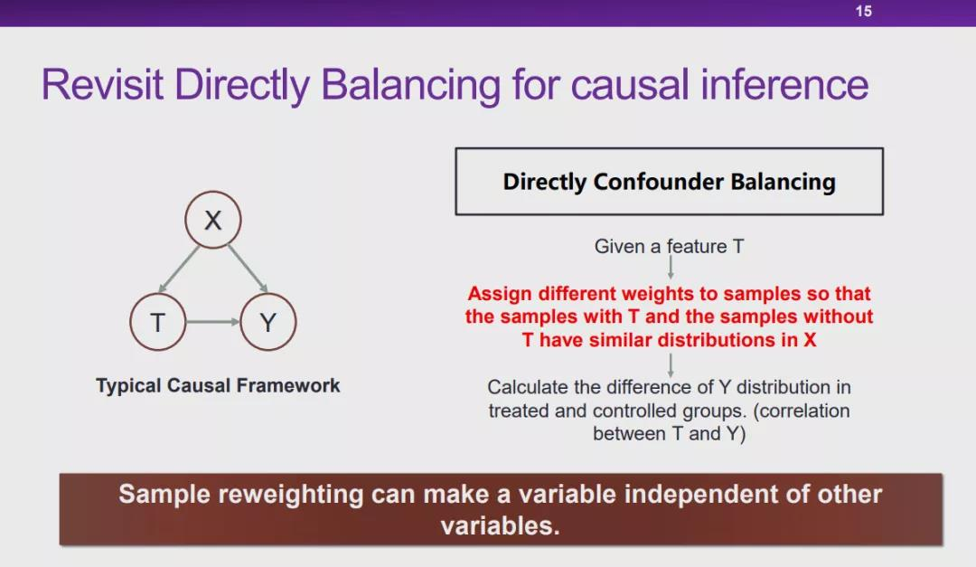
Recap on Stable Learning

Slide 23
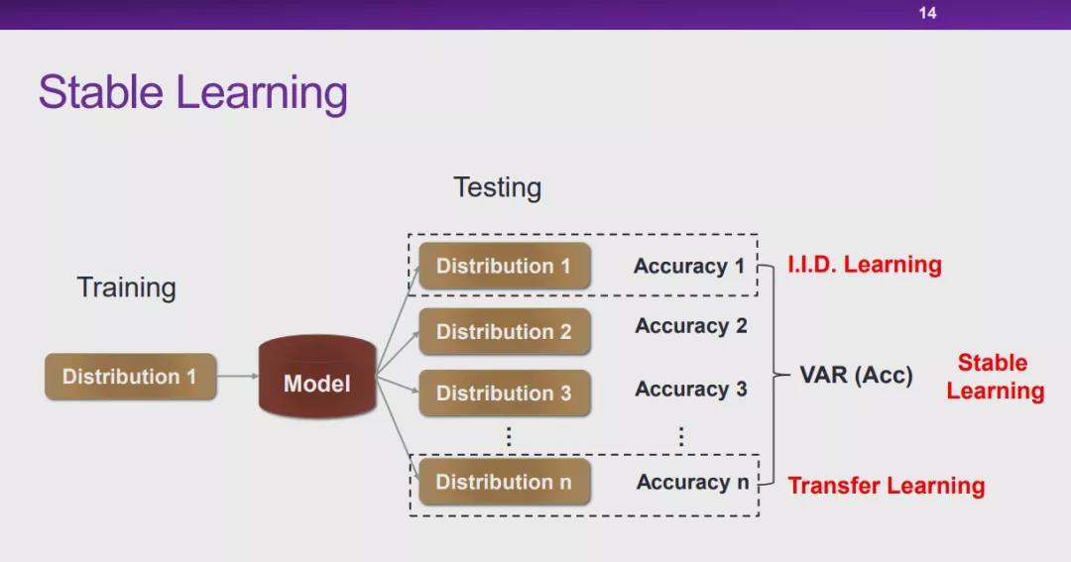
Recap on Stable Learning

Slide 24
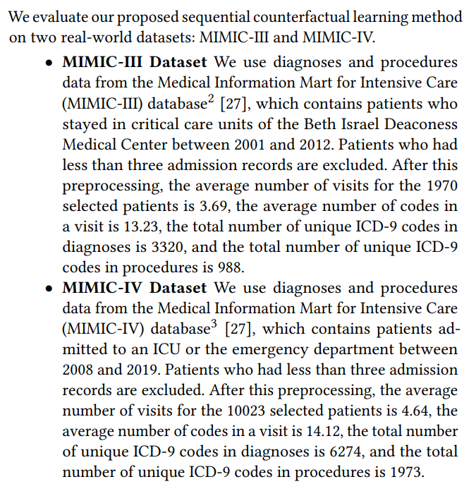
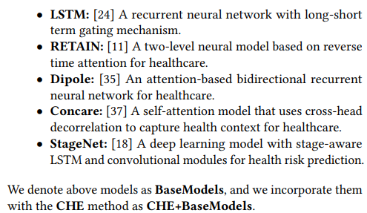
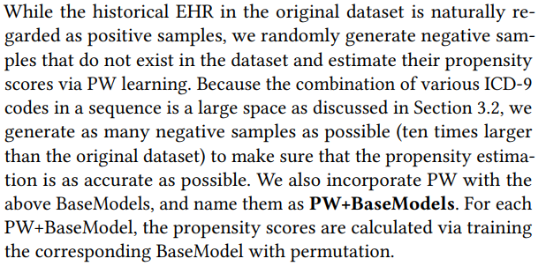
Experimental Datasets & Baselines on EHR

Slide 25
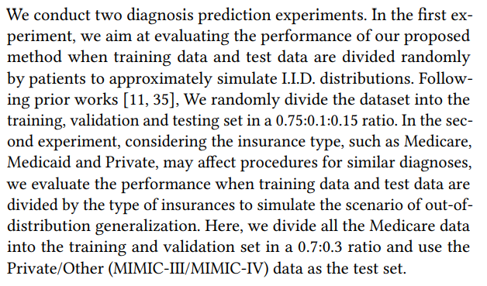
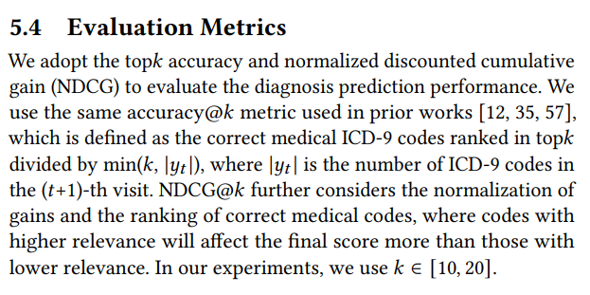
Experimental Setting on EHR

Slide 26
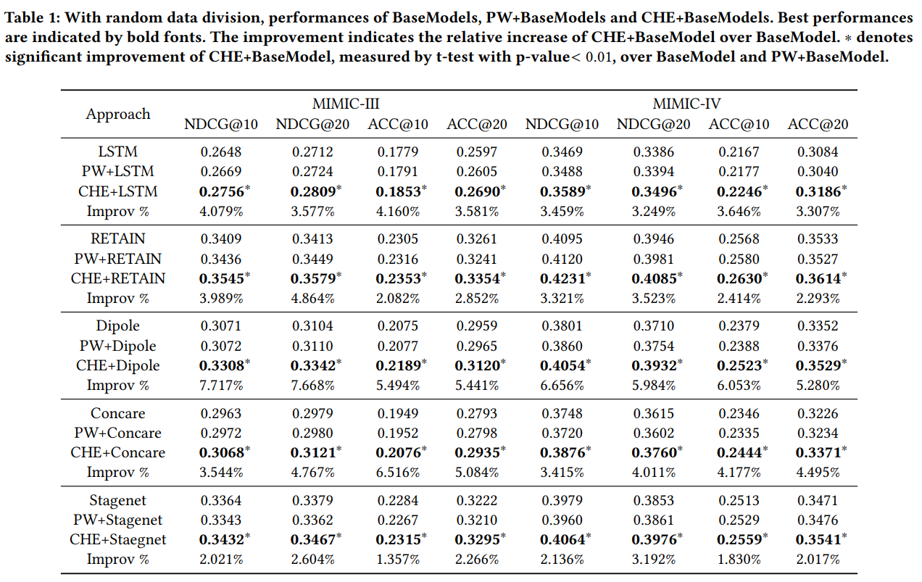
Experimental Results on EHR
NDCG@𝑘 relatively
increases by 4.15%,
and ACC@𝑘 relatively
increases by 3.70%.

Slide 27
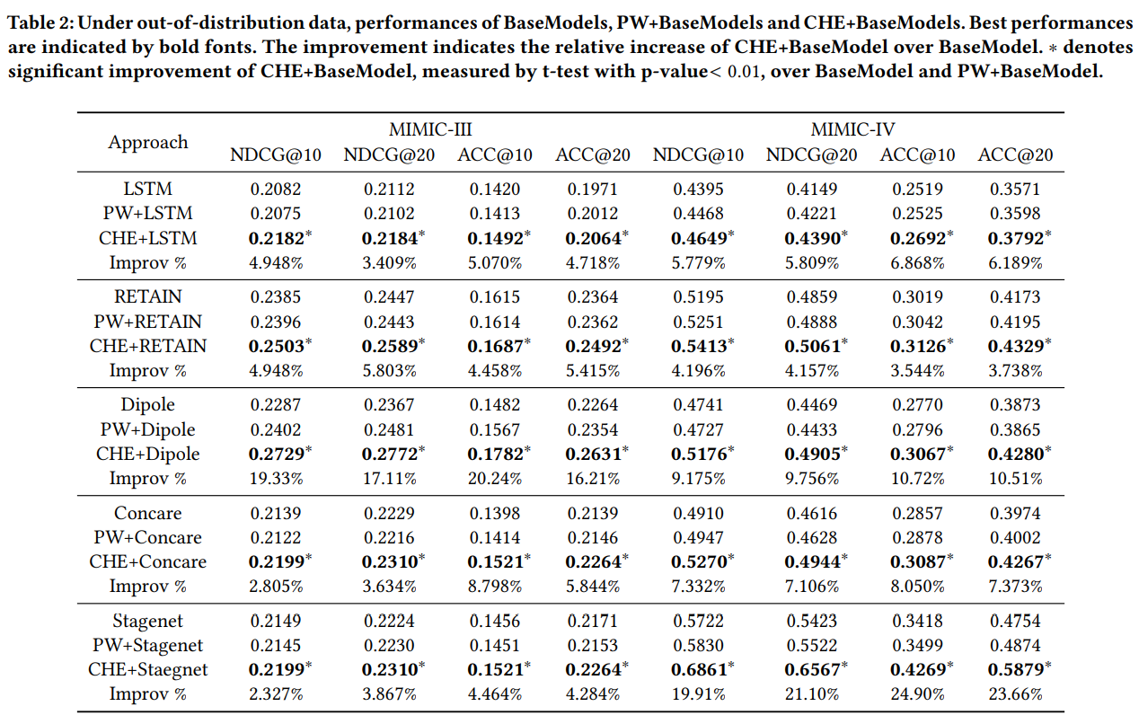
Experimental Results on EHR
NDCG@𝑘 relatively
increases by 8.20%
and ACC@𝑘 relatively
increases by 9.20%.

Slide 28
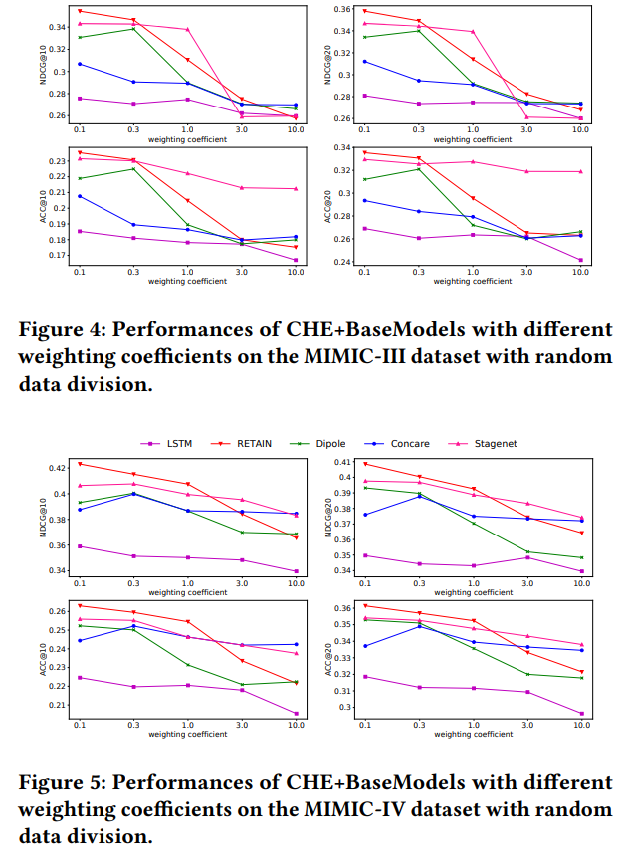
Experimental Results on EHR

Slide 29
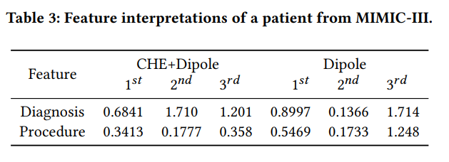
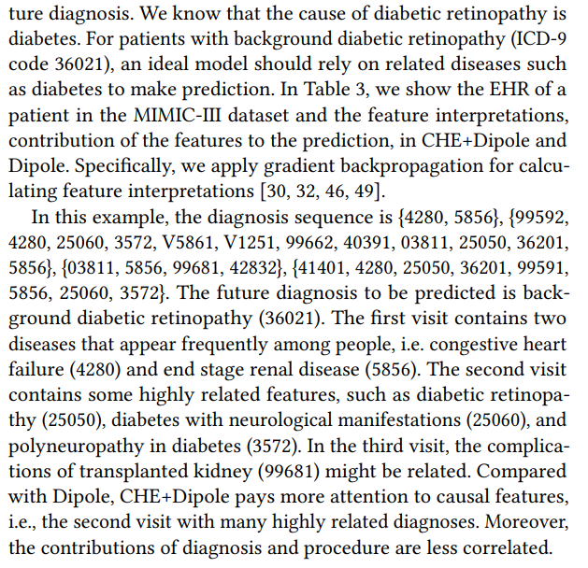
Experimental Results on EHR

Slide 30
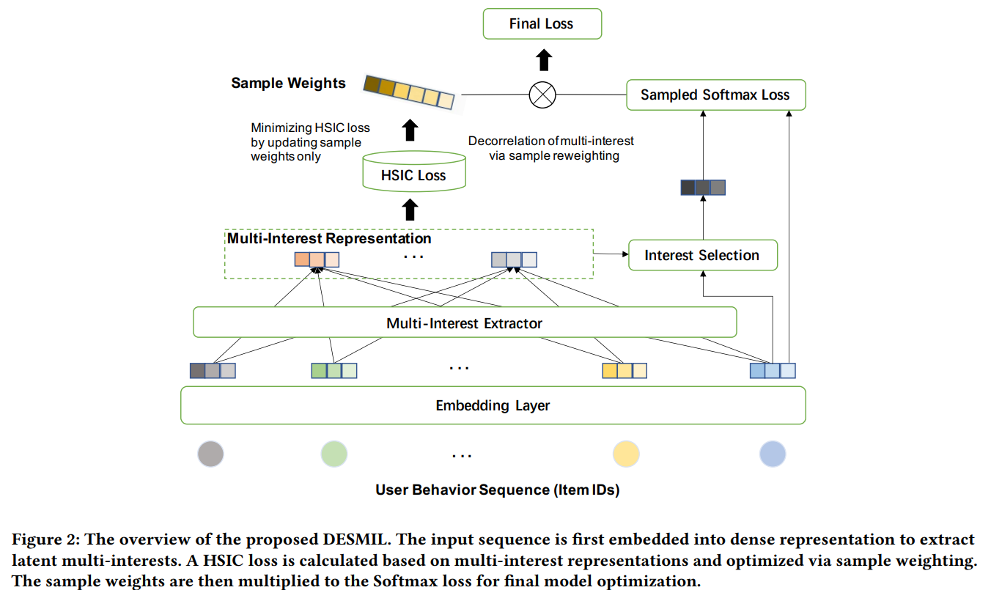
DESMIL - Stable Learning for RecSys

Slide 31
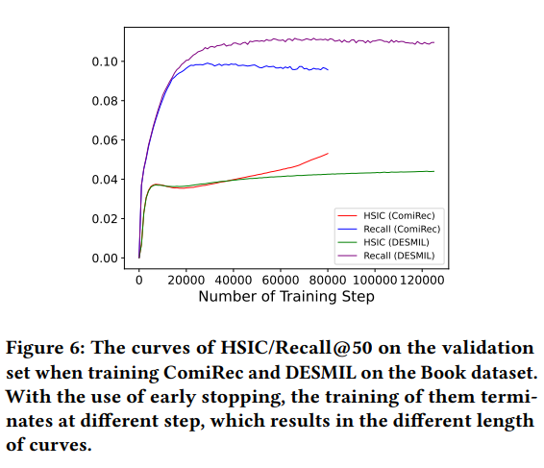
DESMIL - Stable Learning for RecSys

Slide 32
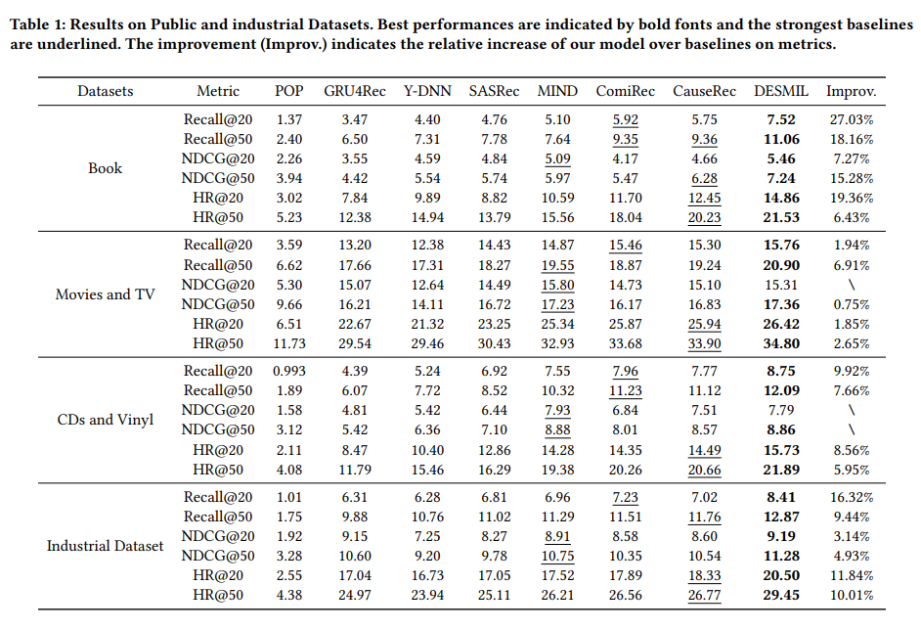
Addendum - Stable Learning for RecSys

Slide 33
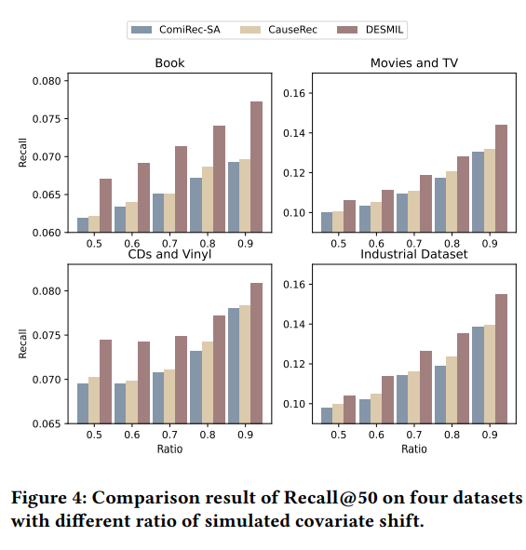
Addendum - Stable Learning for RecSys

